Slide 1
GG News
25th September 2026
Every week tells its own story here at Georgian Gardens, and this week is no exception. The school has been filled with moments that remind us just how much happens within a school day.
From new discoveries and personal achievements to friendship, kindness and laughter, our children continue to bring energy and character to everything they do. As we head towards the weekend, we are delighted to share just a snapshot of another rewarding week in school.
STARS OF THE WEEK:
1KO Ava 1KD Darcy
2MC Victoria 2CA Lola
3VW Ralph 3AE Bonnie
4KC Eva 4TF ELiza
5RD Harley 5CT Eddie
6BA Bailey 6HB Chloe
Attendance
The classes with the highest attendance this week:
2MC, 3VW and 3AE all with 98.7%
(they will have 15 minutes choice of a treat next week).
The child with 100% attendance this week (chosen by a random generator):
Bonnie in 3AE
who gets to choose a book from Miss Bowers’ selection of prize books.

Slide 2


GG News
25th September 2026
Please note: if you placed a meal order for 1st October before the Census Day menu was published you will need to place a new order from the Census Day menu.

Slide 3
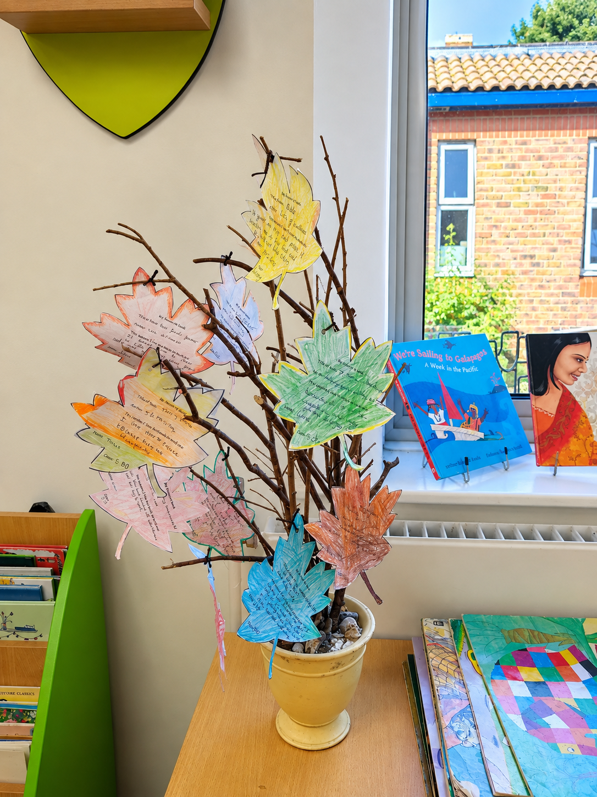
GG News
25th September 2026
Chatterbooks Gets Off to a Flying Start!
Our Year-5 Chatterbooks Club kicked off this week, and every place was snapped up. Ten enthusiastic pupils gathered in the library to swap suggestions, share thoughts, enjoy a quiz, and celebrate great stories together.
One of the highlights was creating a display of favourite reads for everyone to browse with an autumn theme. Now any child popping into the library can check out the book review leaves for plenty of inspiration.
A fantastic start to what promises to be a brilliant year of reading adventures!
Grace Sims, Librarian

Slide 4
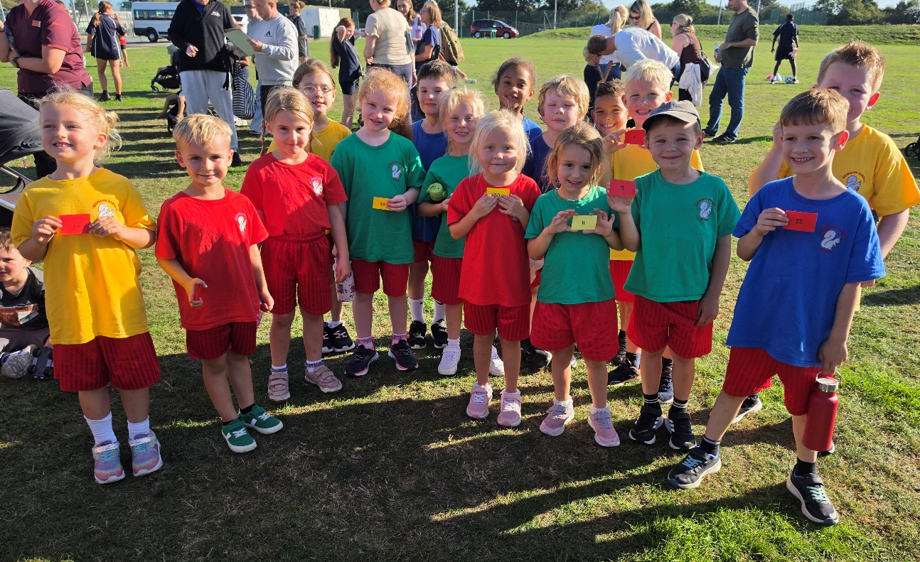
GG News
25th September 2026
KS1 Angmering ½ Mile successes
This Tuesday, KS1 participated in the Angmering ½ Mile. We had an amazing turnout of students, including many first-time runners. Every student ran fantastically well, showing great determination and resilience throughout the event.
A special congratulations goes to our top girl finisher, Robyn (Year 2), and our top boy finisher, Toby (Year 2). Well done to both on their fantastic achievements!
This is a wonderful event that allows everyone to get involved and enjoy being active. We are incredibly proud of all the children who took part.
Our next running event will take place closer to Christmas and will be the Santa Dash!
Next week's event is Year 3 and 4 Basketball. If your child is interested in taking part, please speak to Mrs Roberts.
Well done, everyone!

Slide 5
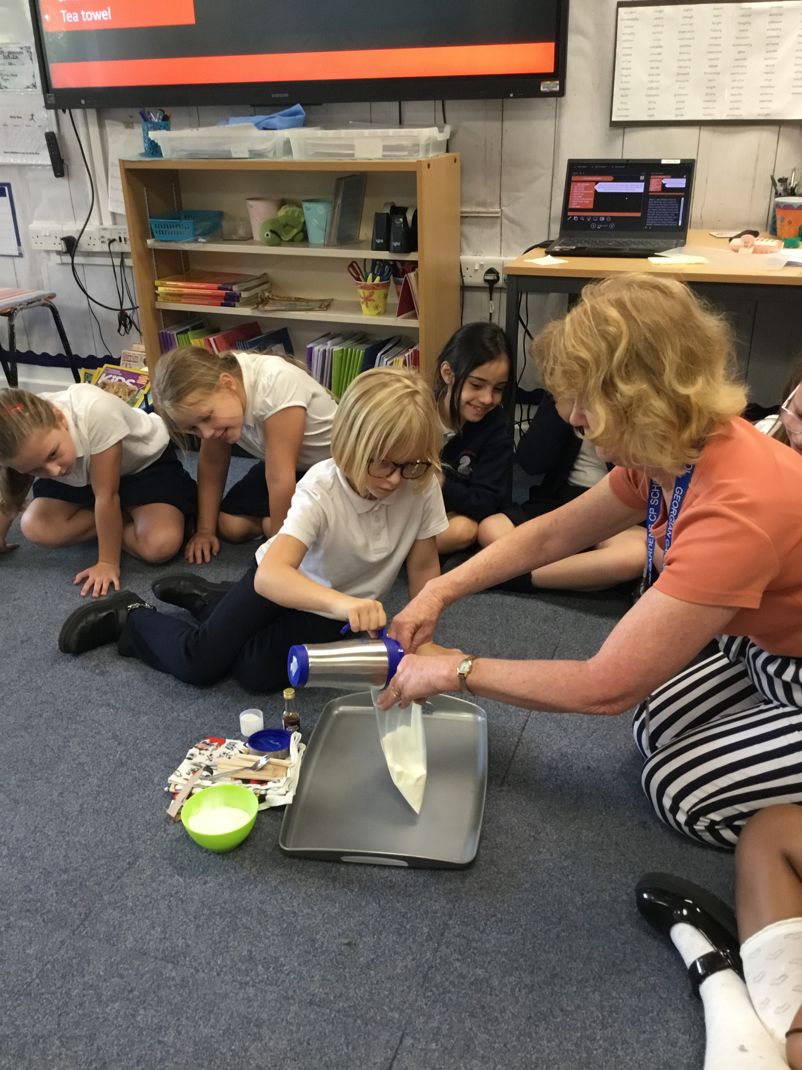
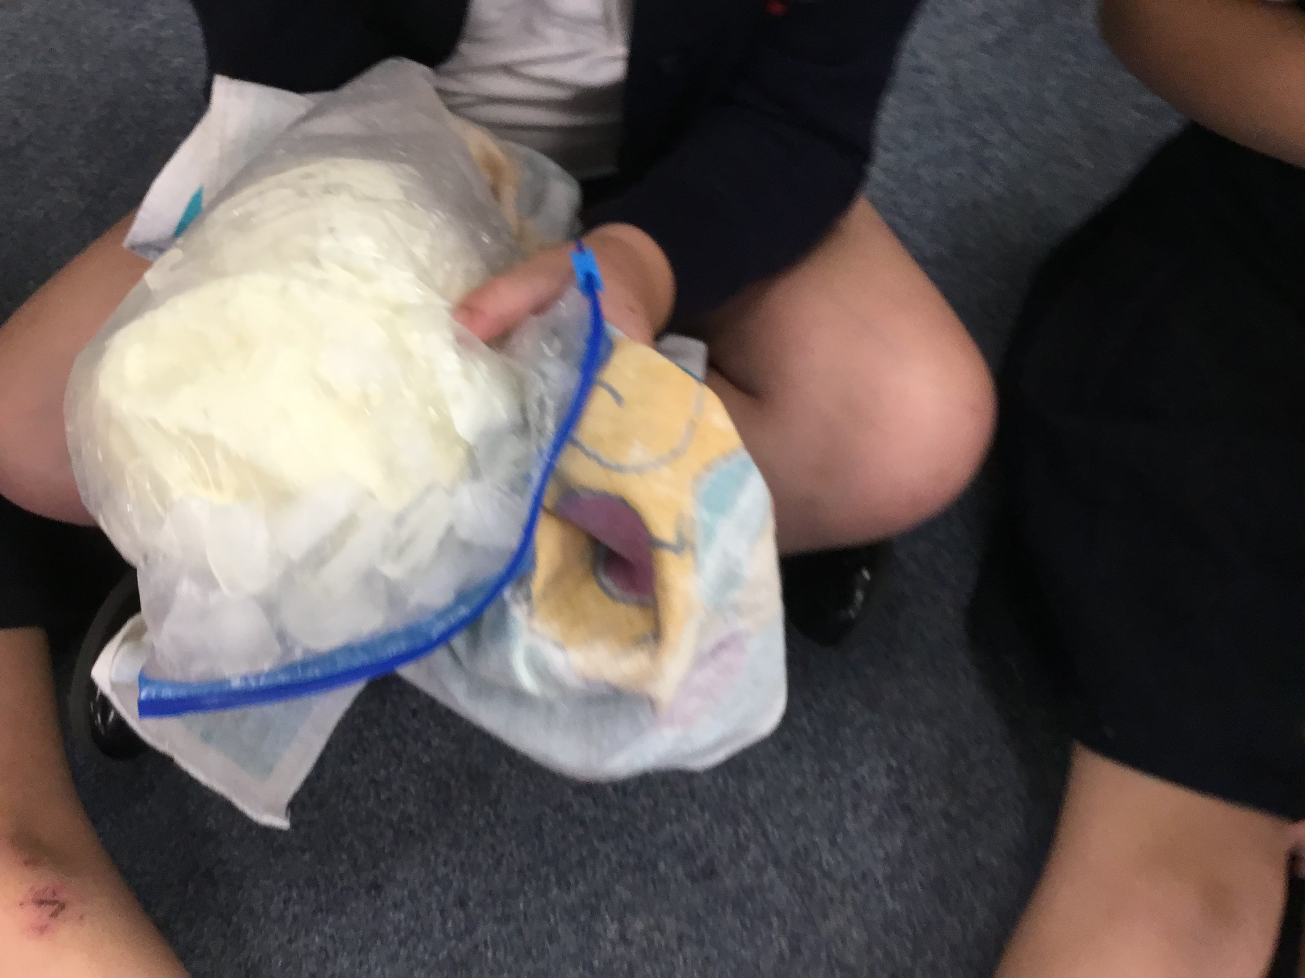
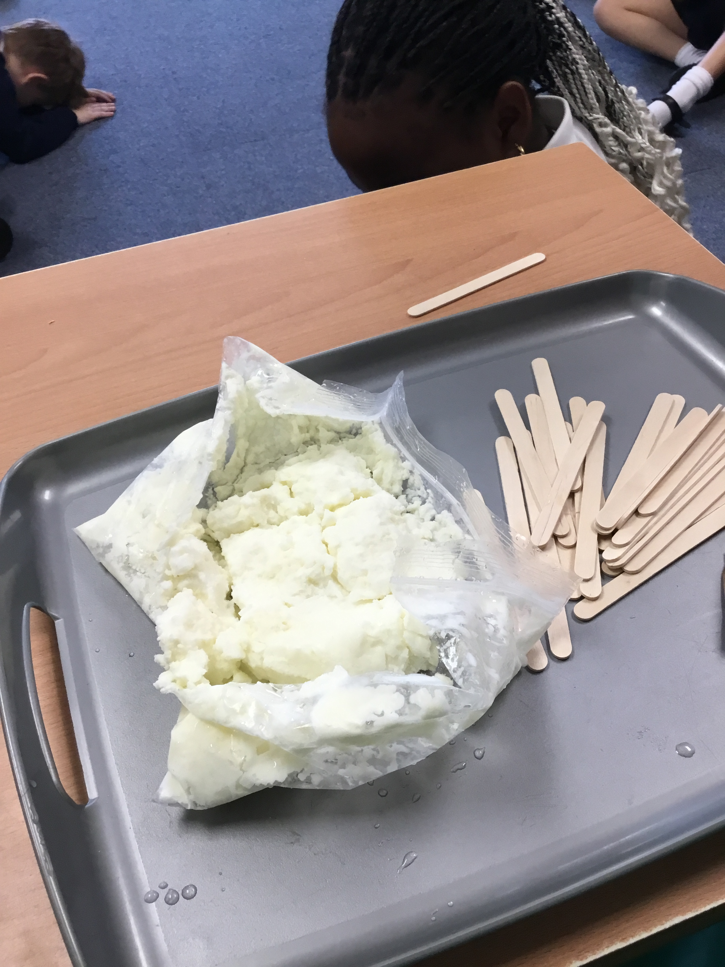
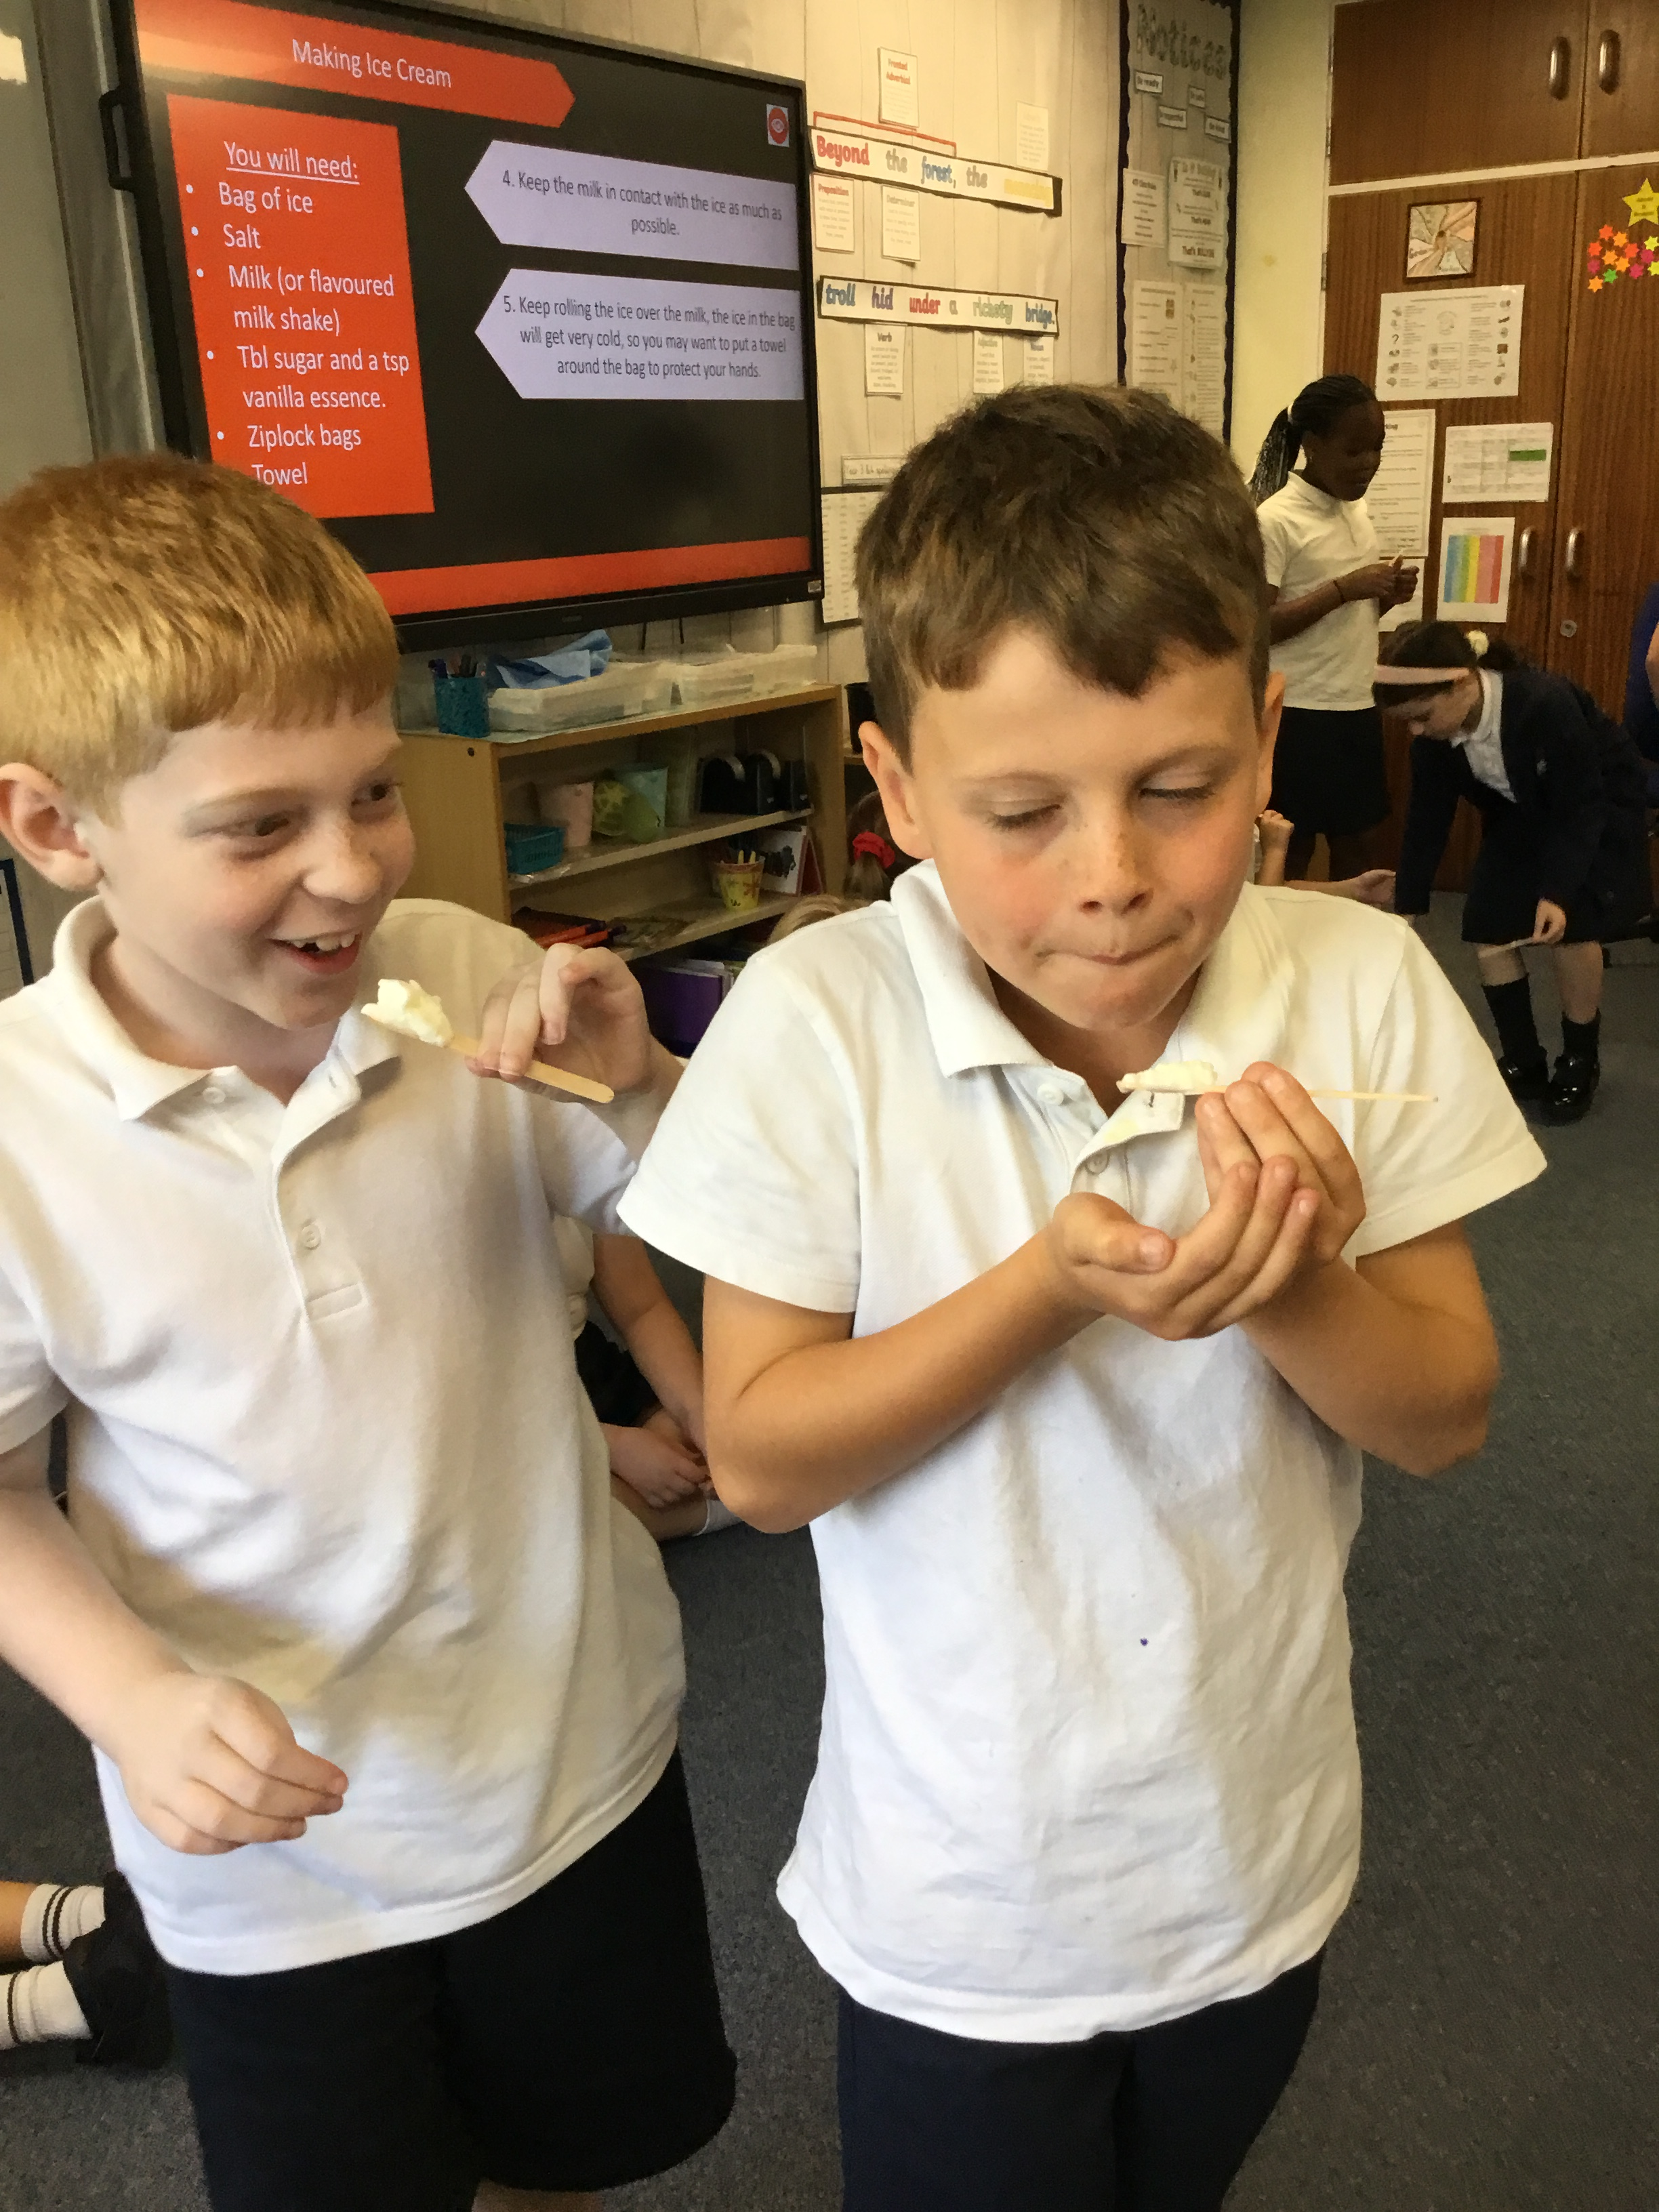
GG News
25th September 2026
Year 4 have been putting their science learning into action this week, with some delicious results! As part of their Solids, Liquids and Gases topic, the children made their very own ice cream and watched first-hand as their liquid mixture changed state to become a solid. They also discovered how adding salt to the ice helped to speed up the process. Of course, no investigation would be complete without the all-important final stage... the taste test!

Slide 6
GG News
25th September 2026
The Children’s Commissioner, Dame Rachel de Souza has asked for children and young people at Georgian Gardens Community Primary School to take part in a national survey called, The Big Future.
The Big Future is asking children and young people about their lives, their experiences and their hopes for the future. Dame de Souza will be using that information to build a national picture of what matters to children today and to ensure their views are heard by the Government.
The survey takes just a few minutes to complete and can be accessed here: https://www.childrenscommissioner.gov.uk/thebigfuture

Slide 7
GG News
25th September 2026
Car Park Use – Changes
From Monday 28th September, the school car park gates will be closed from 8.30am and again from 3pm.
This is to ensure that there is no movement of vehicles at these times when pedestrian use is at its highest in the car park area. The gates will be reopened once the majority of pupils are safely out of the area.
Parents who do not have a blue badge or permit are not allowed to use the car park between the hours of 8am and 4pm.
We have tried to speak with those who have a blue badge or permit individually this week so that they are aware of the changes (apologies if anyone has been missed).
It is essential that we all work together to keep pupils safe and I would like to thank those that I have spoken to for their support in this decision.
Please can all parents try to encourage pupils to use the footpaths to walk on, ensuring safety at all times.
Miss Bowers

Slide 8

GG News
25th September 2026
DATES FOR YOUR DIARY
Please note change in Year 6 productions dates in July
Key dates for 2026- 2027
Prospective families open event for Children starting School in September 2027 | Wed 30th Sept – Open Morning, 9:30am – 11am Sat 3rd Oct – Open Morning, 10am – 12pm Tues 10th Nov – Open Afternoon, 1pm – 3pm Tues 17th Nov – Open Evening, 6pm – 7pm Thurs 26th Nov – Open Morning, 9:30am – 11am
Parents’ Evenings 3:30pm – 6pm | 20th Oct & 22nd Oct 24th Feb & 25th Feb |  |  | **book fair 23/2/27 – 2/3/27)**
Open Classrooms From 2:45pm | 23rd Nov | 22nd March |  |  | 21st June
Nativity 9:30am | 7th, 8th, 9th Dec
Reports | To SLT by 11th June |  | Out to parents 12th July
Sports Day KS1 am KS2 pm | 17th June (24th June reserve)
Summer Fair 3:30 – 5:15pm | 25th June
Y6 production 1:30pm / 6:30pm | 13th & 15th July
Y6 presentation eve 6pm – 7pm | 19th July
The safety and wellbeing of all our children is our highest priority.
We kindly remind families that we are a nut-free school and ask that no nut products, including peanuts and items containing nuts, are brought into school lunches or snacks.
Even trace amounts can pose a serious risk to children with severe allergies.

