Slide 1
GG News
18th September 2026
It has been another brilliant week here at Georgian Gardens. The pupils have been working very hard and Miss Bowers was particularly proud of the year 2 writing this week!
In assembly we found out who our new Year 6 House Captains and Vice Captains are. Well done to everyone who was elected!
Arundel House Captains: Jenson & Poppy P
Arundel Vice Captains: Ozzy & Isla C
Amberley House Captains: Isla G & Elliott
Amberley Vice Captains: Violet & Zachary
Bramber House Captains: Theo & Chloe
Bramber Vice Captains: William & Katie
Lewes House Captains: Ronnie & Libby
Lewes Vice Captains: Leo & Phoebe
STARS OF THE WEEK:
1KO Maddison 1KD Ruby
2MC Damien 2CA Ella
3VW Gracie 3AE Evie
4KC Emily 4TF Noah
5RD Niamh 5CT Monty
6BA Rosiee 6HB Carter
Attendance
The class with the highest attendance this week:
2MC 99.2%
(they will have 15 minutes choice of a treat next week).
The child with 100% attendance this week (chosen by a random generator):
Damien in 2MC
he gets to choose a book from Miss Bowers’ selection of prize books.

Slide 2



Slide 3
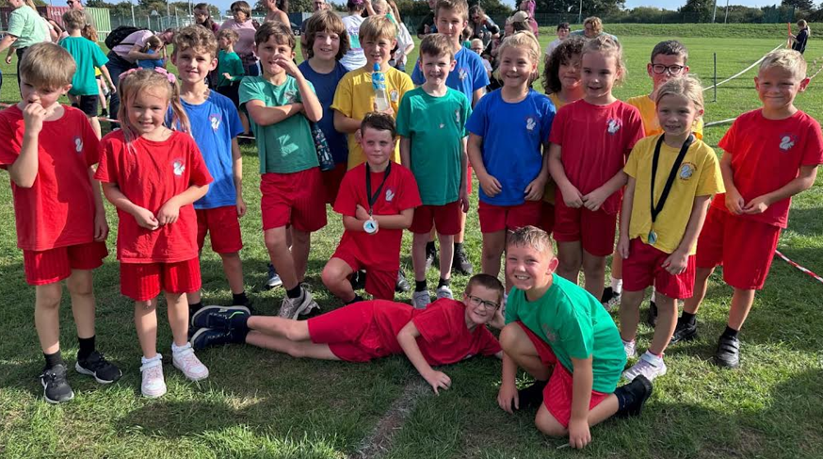

GG News
11th September 2026
On Tuesday we kicked off GG Sport with KS2 Angmering Mile. The students competed against five different schools it was so great to see so many children participating. All students showed courage, determination and teamwork. Our top girl finisher was Sophia Kinal from Year 3 and our top boy finisher was Oliver Massey from Year 4. Well done to everyone who took part this is a very challenging event. There is still plenty of time to sign up for the KS 1 half mile next Tuesday.

Slide 4

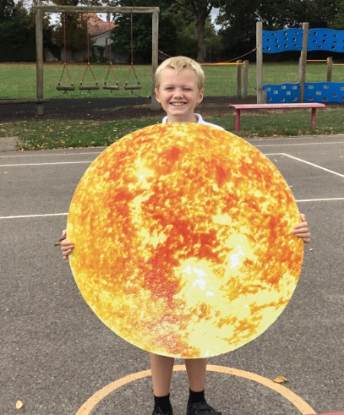
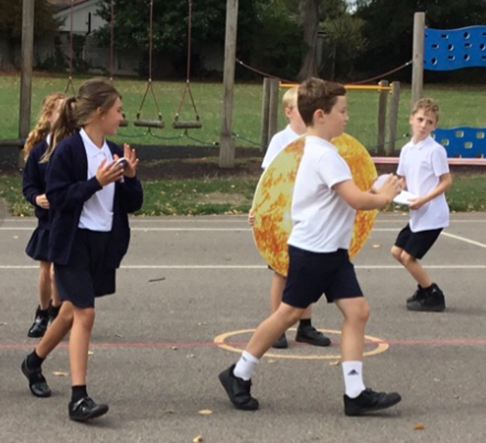
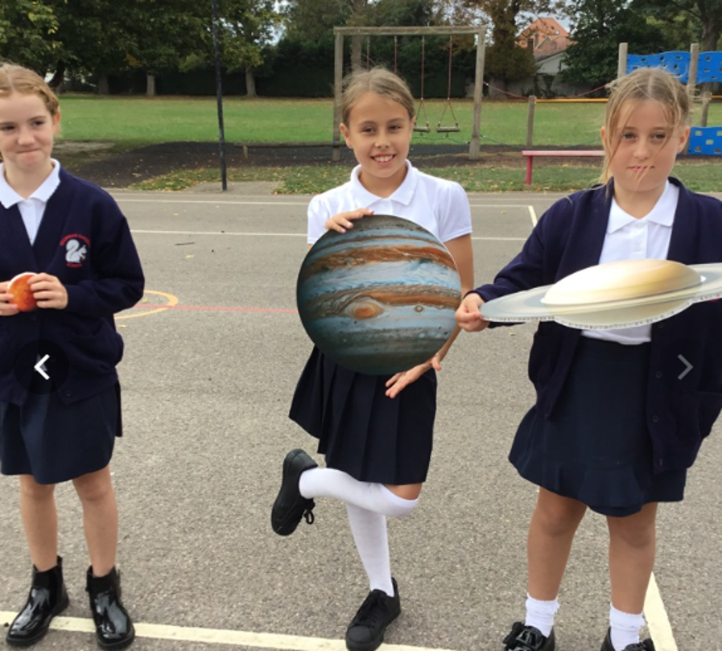
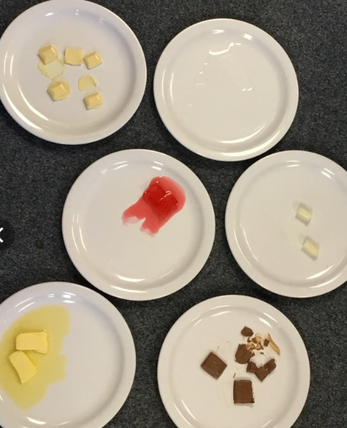
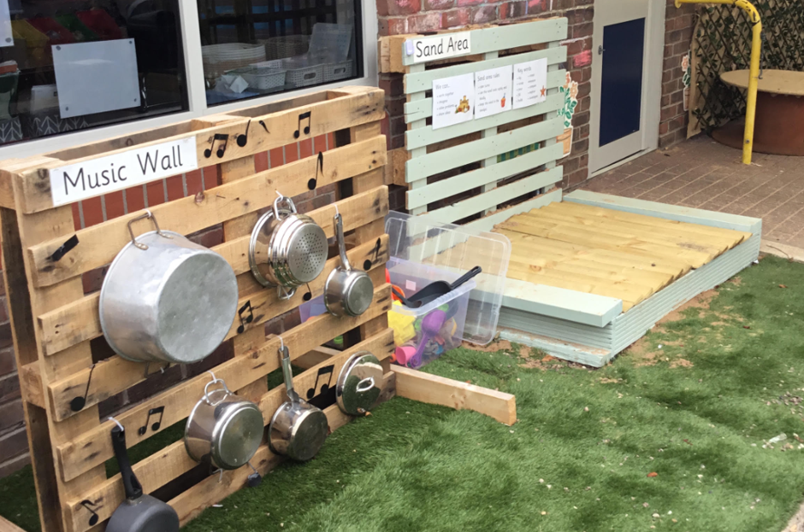
GG News
18th September 2026
Year 5 have been learning about the planets and ordering them on the playground
Year 4 have been learning about changes of state
Have you seen the brilliant new investigation play areas outside Year 1? – Well done teachers!

Slide 5
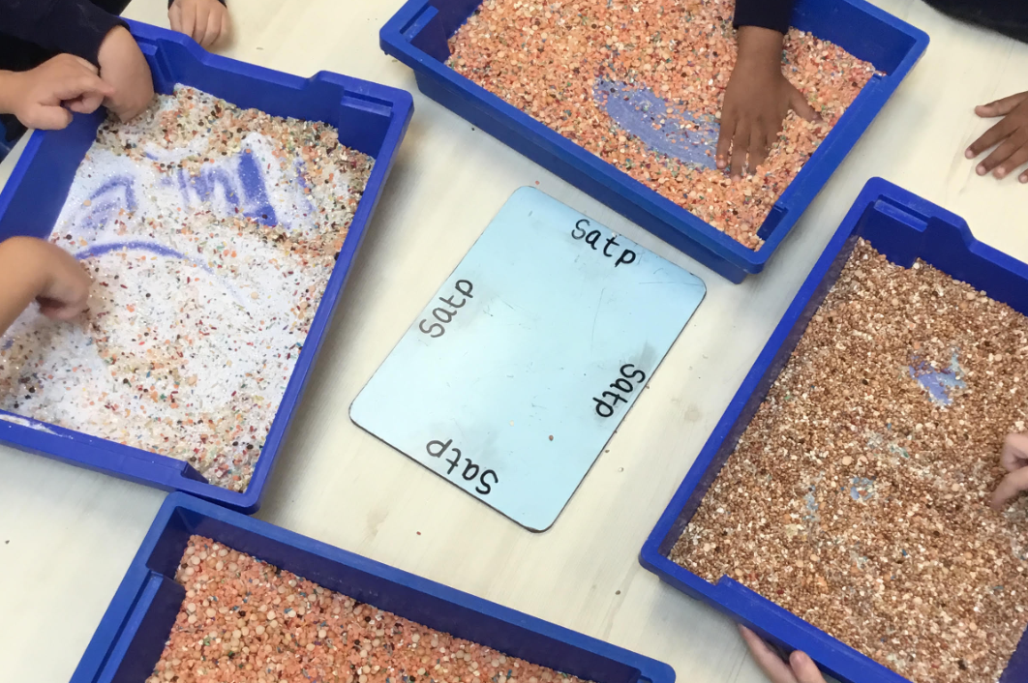
GG News
18th September 2026
We are so proud of how our Year R pupils are settling into school routines.
Today the children were learning to create the shapes of some letters in lots of different materials.

Slide 6


GG News
18th September 2026
Our PTA plays a vital role in enriching school life, and we warmly encourage parents and carers to join.
Whether you can offer a little time or a lot, your support makes a real difference.
The safety and wellbeing of all our children is our highest priority.
We kindly remind families that we are a nut-free school and ask that no nut products, including peanuts and items containing nuts, are brought into school lunches or snacks.
Even trace amounts can pose a serious risk to children with severe allergies.

Slide 7
GG News
18th September 2026
DATES FOR YOUR DIARY
Key dates for 2026- 2027
Prospective families open event for Children starting School in September 2027 | Wed 30th Sept – Open Morning, 9:30am – 11am Sat 3rd Oct – Open Morning, 10am – 12pm Tues 10th Nov – Open Afternoon, 1pm – 3pm Tues 17th Nov – Open Evening, 6pm – 7pm Thurs 26th Nov – Open Morning, 9:30am – 11am
Parents’ Evenings 3:30pm – 6pm | 20th Oct & 22nd Oct 24th Feb & 25th Feb |  |  | **book fair 23/2/27 – 2/3/27)**
Open Classrooms From 2:45pm | 23rd Nov | 22nd March |  |  | 21st June
Nativity 9:30am | 7th, 8th, 9th Dec
Reports | To SLT by 11th June |  | Out to parents 12th July
Sports Day KS1 am KS2 pm | 17th June (24th June reserve)
Summer Fair 3:30 – 5:15pm | 25th June
Y6 production 1:30pm / 6:30pm | 13th & 15th July
Y6 presentation eve 6pm – 7pm | 19th July
Please note change in Year 6 productions dates in July
CAR PARKING
Parking in the staff car park is only allowed before 8am and after 4pm (for HIVE / clubs)
Only permit holders / blue badges are allowed in at other times. THIS IS FOR OUR CHILDREN’S SAFETY
Please remember to always park for consideration to our neighbours. All residents need clear access to their vehicles and driveways.
Thank you

Slide 8

GG News
18th September 2026

